Slide 1
Final Presentation
Team Blue

Slide 2
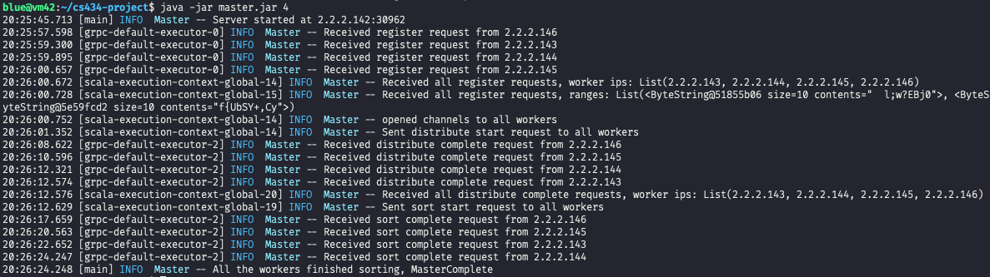
Test Result
Completed in ~40s
4 worker nodes with 2 * 32MB input files each
More test cases at the github repo

Slide 3




Test Result
By shell script(written by github copilot)
Check each worker’s integrity -> checked whole workers
Worker 1
Worker 2
Worker 3
Worker 4

Slide 4

Test Result
By shell script(written by github copilot)
Check each worker’s integrity -> checked whole workers

Slide 5
Milestones
Milestone 1
Generate input data - done
Connect Master & Worker nodes - done
Configure gRPC - done
Milestone 2
Worker samples data: done
Master computes ranges for each worker nodes given worker's range -> distribute it to workers with (range, ipaddress) list: done
Workers merge data : Moved from 3 to 2, done
Can execute(send) protocols in other, concurrently in Worker & Master using future & promise with dummy data, done
Milestone 3
Workers sort and partition its data (should decide the size of partitioned file - done) - done
Workers distribute its files to appropriate node range. - done
Workers terminate & notify master - done
Can execute(send) protocols in other, concurrently in Worker & Master using future & promise with real data (merge top-down & bottom-up work) - done

Slide 6
What we did
Jeongho:
Overall design
Master/Worker general control/communication flow
Local sorting
Attach sample/merge logics

Slide 7
What we did
Jihun:
Overall design
Sample/Merge logics
Integration/Smoke test

Slide 8
Design
No polling(no while() {sleep})
Only Future, Promise
Terminology
Distribute = shuffle
Sort = merge

Slide 9
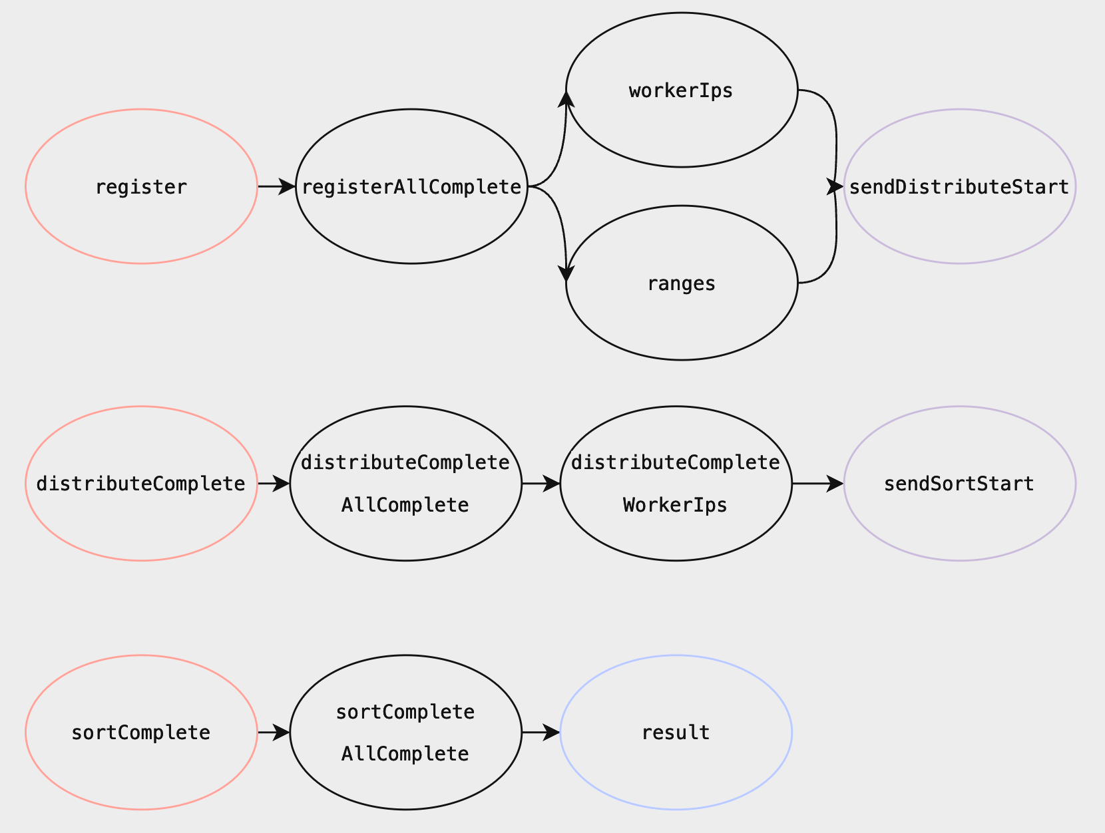
Master
Pink: gRPC Service
Black: Promise(or Future)
Purple: function returning Future[Unit]
Blue: Result of Await.Result

Slide 10
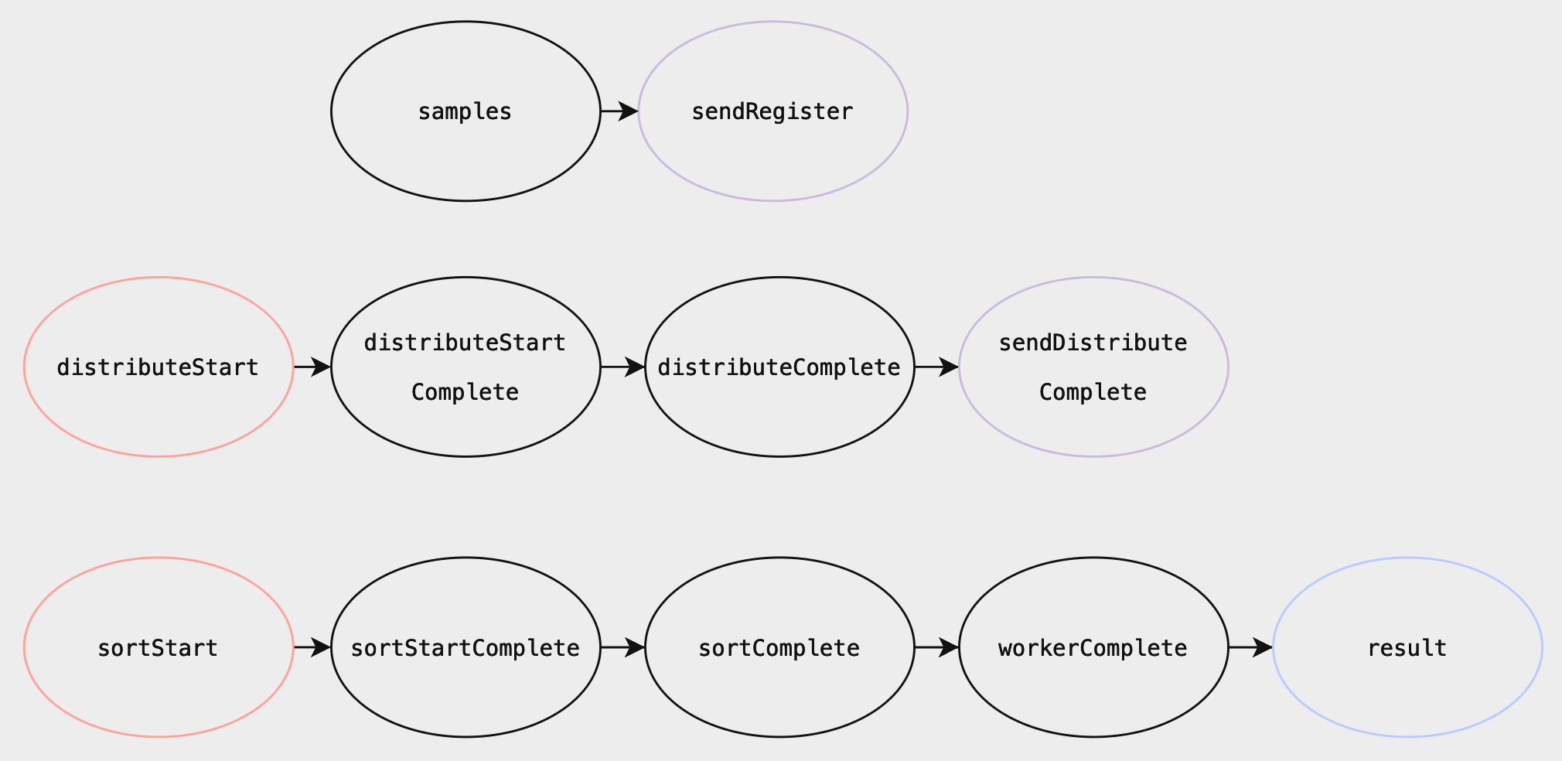
Worker
Pink: gRPC Service
Black: Promise(or Future)
Purple: function returning Future[Unit]
Blue: Result of Await.Result

Slide 11
worker
master

Slide 12
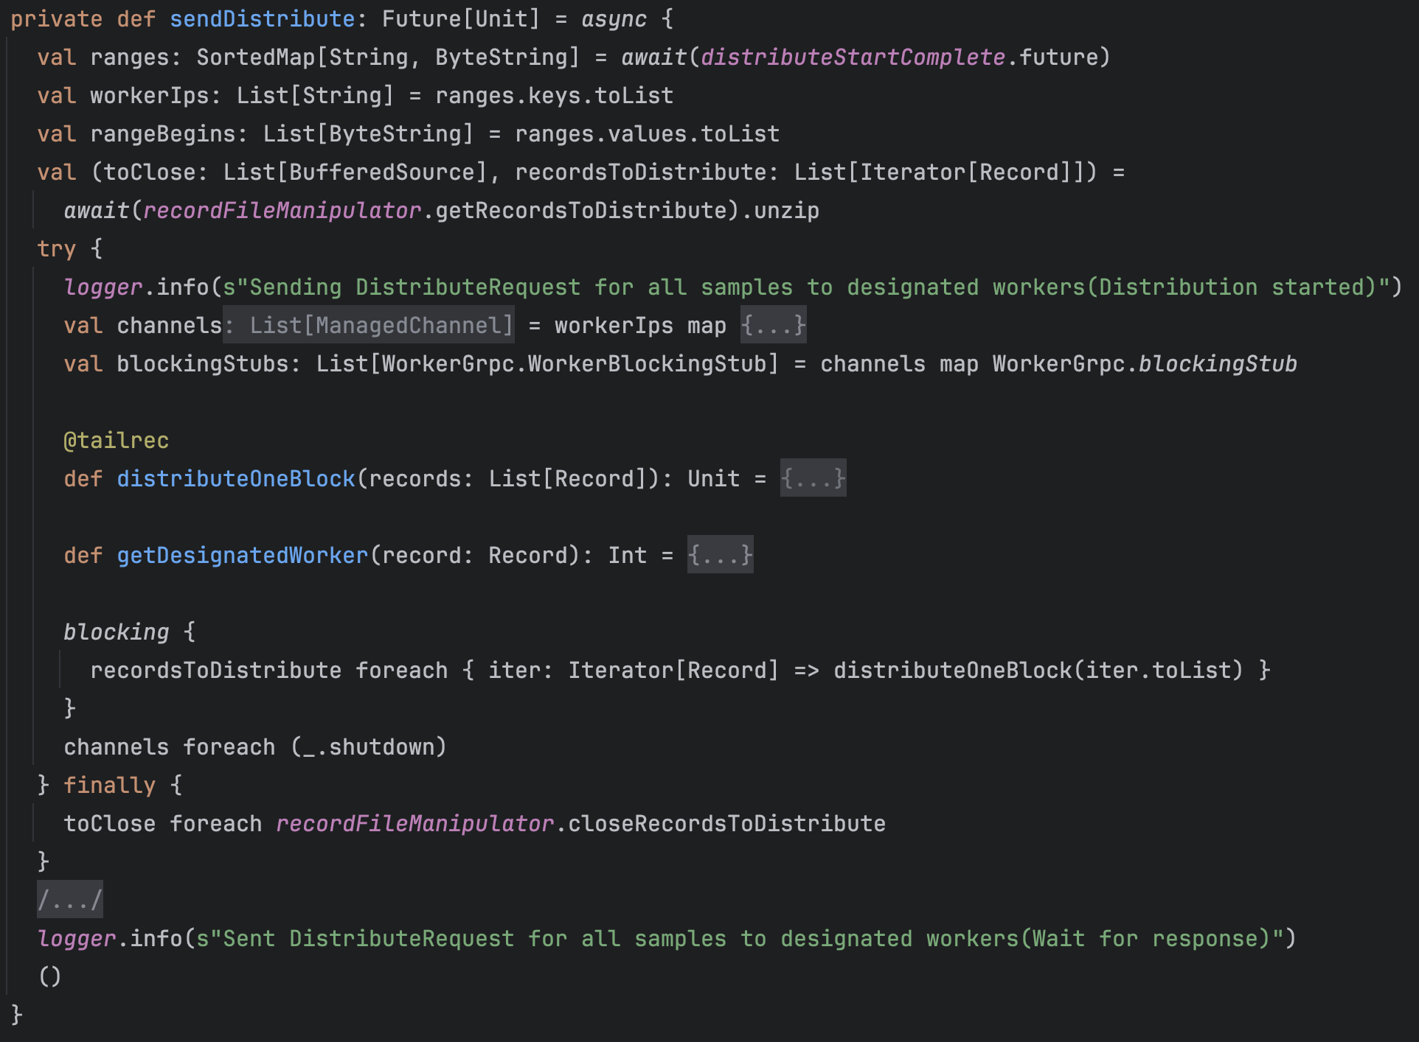
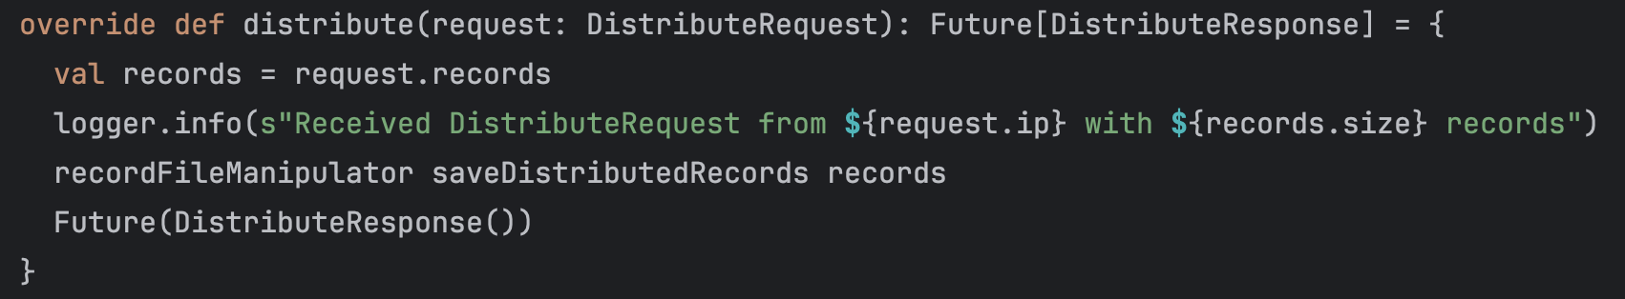
Distribute(Shuffling)
Shuffling is done in sendDistribute. sendDistribute sends distribute requests.
When worker receives a distribute request(containing records less than 2MB), it simply saves the records as a file.

Slide 13
Merging
Need to merge “m” sorted record blocks into 1 sorted record block.
Let there are total ”n” records.
We need to find the smallest record among m blocks. (and repeat this n times)
Basic way is to simply compare m times O(n m)
We use tournament tree O(n log m)
If there are total 2GB of records, m is 2 GB / 2 MB = 1000.
m increases linearly as the total size increases

Slide 14
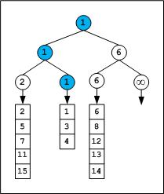
Tournament tree
Basically a modified merge sort

Slide 15
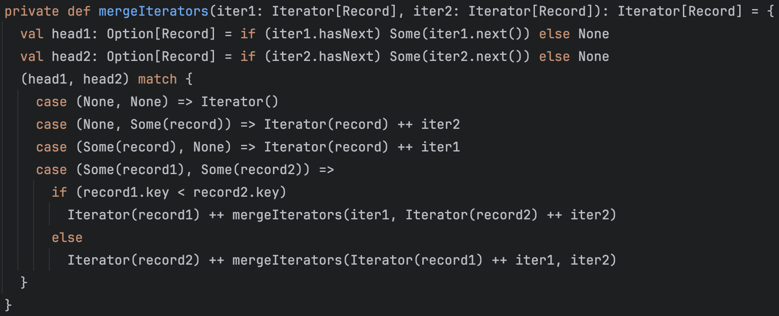
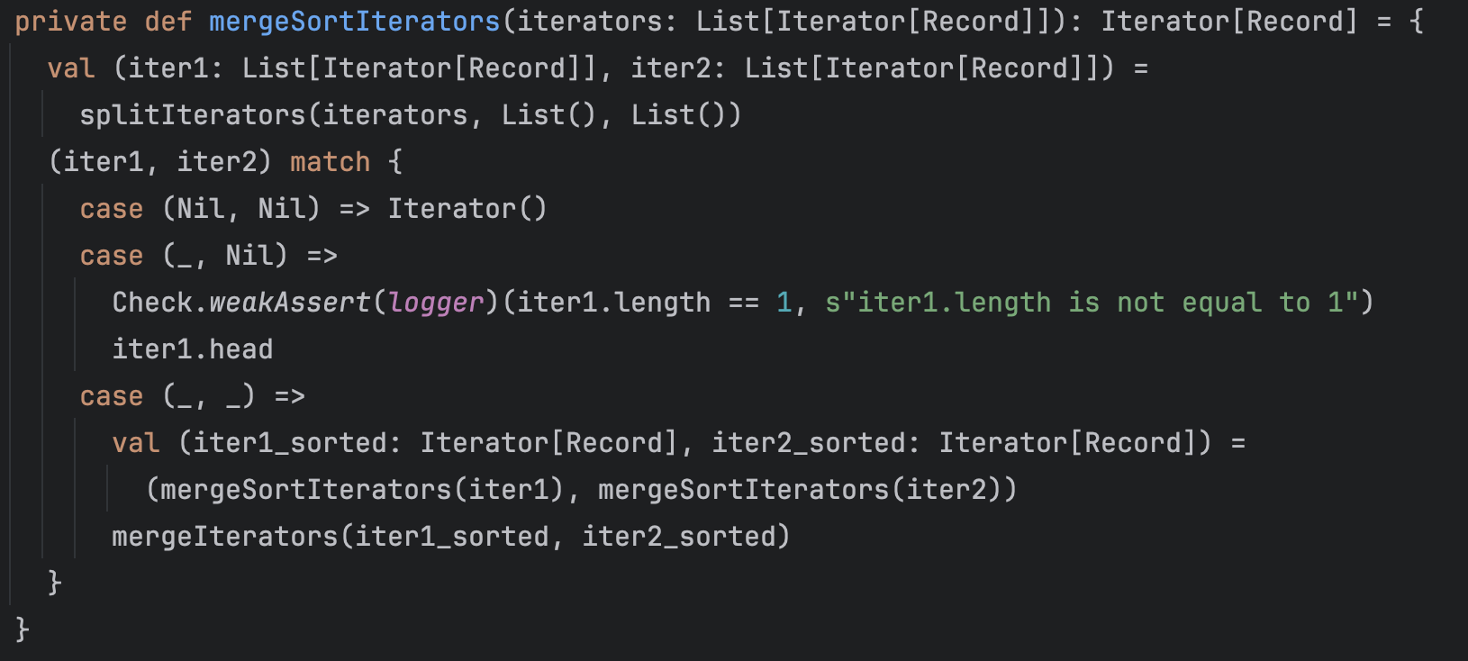
Tournament tree
Implemented in RecordFileManipulator

Slide 16
Design Remarks
Control states as future & promise to schedule the overall flow
Sort&Sample before register to the master
Separate DistributeStart/DistributeFinish & SortStart/SortFinish requests so that the distribution and sorting(merging) does not happen in the httpclient’s request-response context
Decided the size of temp&output files as 2MB, because of OOM error during file save

Slide 17
If we were to redo the project from beginning
Jihun:
Decide the data representation of the saved file & protocol & method interfaces first more than anything else.
Change the signature and communication protocol more test friendly
Set detailed milestone & due date
Jeongho:
Think more about time complexity(e.g., list concat vs flatmap?, list or cats chain?)
Automate testing, formatting

